Slide 1

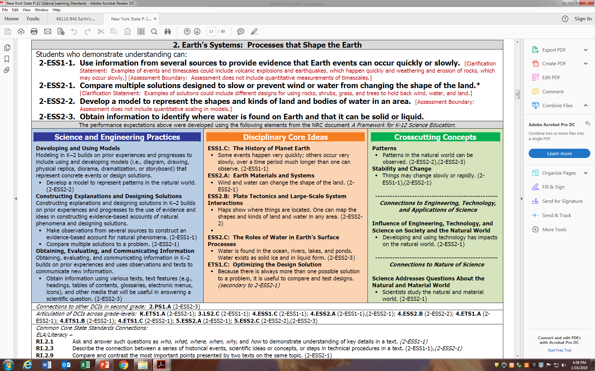
Earth’s Features
Explore the features of Earth at home.
https://sites.google.com/wflboces.org/boces4science/home
Grade 2

Slide 2
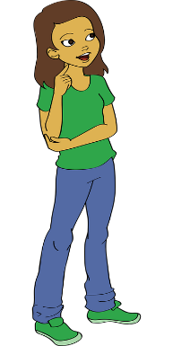
BOCES 4 Science Kit: Earth’s Features
  Anchoring Phenomena: Where should Tina live?
Tina’s Story Line:
Tina has been traveling and exploring all over the world, but now she is ready to settle down in the
United States. Each of Tina’s family members want her to settle down near them.
Tina needs the students’ help deciding where she should settle down. As she visits each place,
she sends a postcard describing the location to the students. As the unit progresses, students gather
information about landforms and water features from multiple sources, and learn how Earth’s surface
is affected by fast and slow changes. At the end of the unit, students make informed opinions and
write to Tina to help her decide where she should live.

Slide 3
1. What are Earth’s Features?
2. Where do we find Earth’s Features?
Options to help students learn about Earth’s features.
  Flat Stanley – A whimsical tale about a boy, who was flattened, and mailed to different locations. As this tale caught the interest of teachers it was suggested that a picture of “Stanley” be mailed from different family members or shown on a text or email from all around the country. This could be a great way to introduce students to different Earth features. Here is a link to the online book: https://www.youtube.com/watch?v=PVsiFx9ZyFo I suggest increasing the speed to 1.25 normal speed. (use the gear icon of the youtube bottom menu bar)
  Where’s Waldo could be a cute way to have students find Waldo on different Earth’s Features.
  Google Earth: https://www.google.com/earth/ is a great way for students to explore the wonders of our Earth and and zoom in specific regions.

Slide 4
Videos
https://www.youtube.com/watch?v=BsqKTJtK_vw – this is a great video on many types of landforms and bodies of water
https://www.youtube.com/watch?v=KWTDmg8OI_Y – Dr. DeMaio explains different land forms (a bit quirky)
https://www.youtube.com/watch?v=FN6QX43QB4g – Crash Course for Kids. Mostly about landforms but a bit of water. I recommend changing the speed of the video to 75%
https://www.youtube.com/watch?v=_P3nAWvxKz8 – no speaking in this just shows different landforms with a label identifying it.
https://www.youtube.com/watch?v=pkjJsYsy5cA this is a low level video introducing Earth Features vocabulary
https://www.youtube.com/watch?v=dk8zDjQT0aE – this video is more basic about continents, oceans, countries, etc… a good link to social studies.

Slide 5
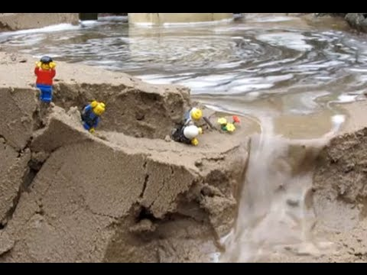
Go Outside!
Have students go outside and look around. Maybe they will see a hill, mountain, pond, lake, or maybe nothing that they recognize. Allow them time to look closely.
Have students take a small figure like a Lego person outside. Find some dirt or mounds in your yard. Have them build different landforms for the figure. Students can label the different landforms they make.
https://www.youtube.com/watch?v=KXZV7rmuUMI

Slide 6
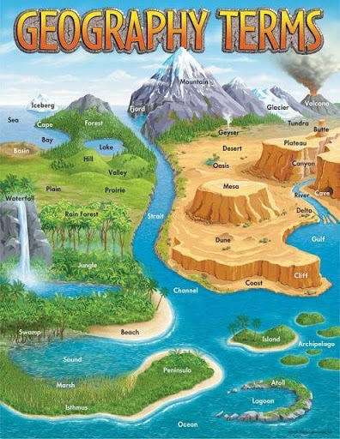
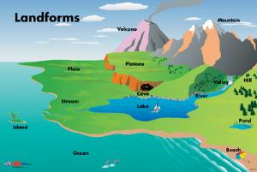
https://www.wardsci.com/store/product/8873284/elementary-geography-terms-poster-td-ct-24-x-36
http://www.cinemaperaestudiants.cat/activitats/Activitats2016/TSSPIVET/spivetgeography.htm

